Slide 1
Image Steganography

Slide 2
Agenda
Introduction to Steganography
Concept of Image Steganography
Implementation of Image Steganography
Demonstration of Image Steganography
Conclusion
Future Enhancement

Slide 3
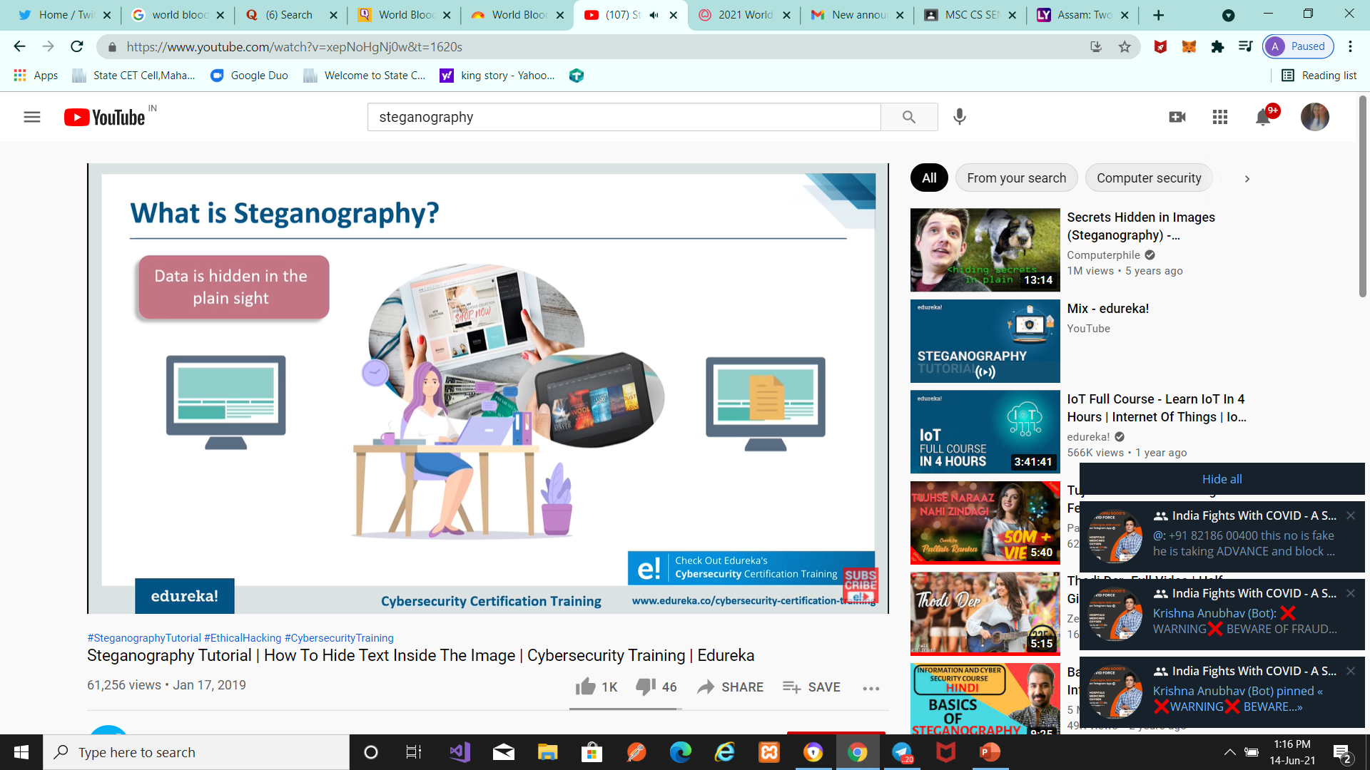
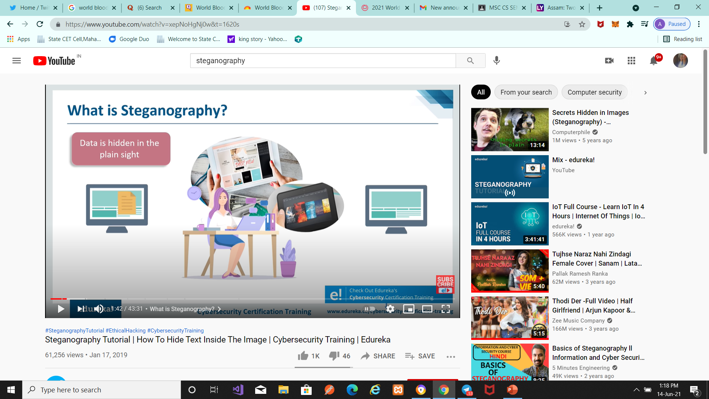
Introduction to Steganography

Slide 4
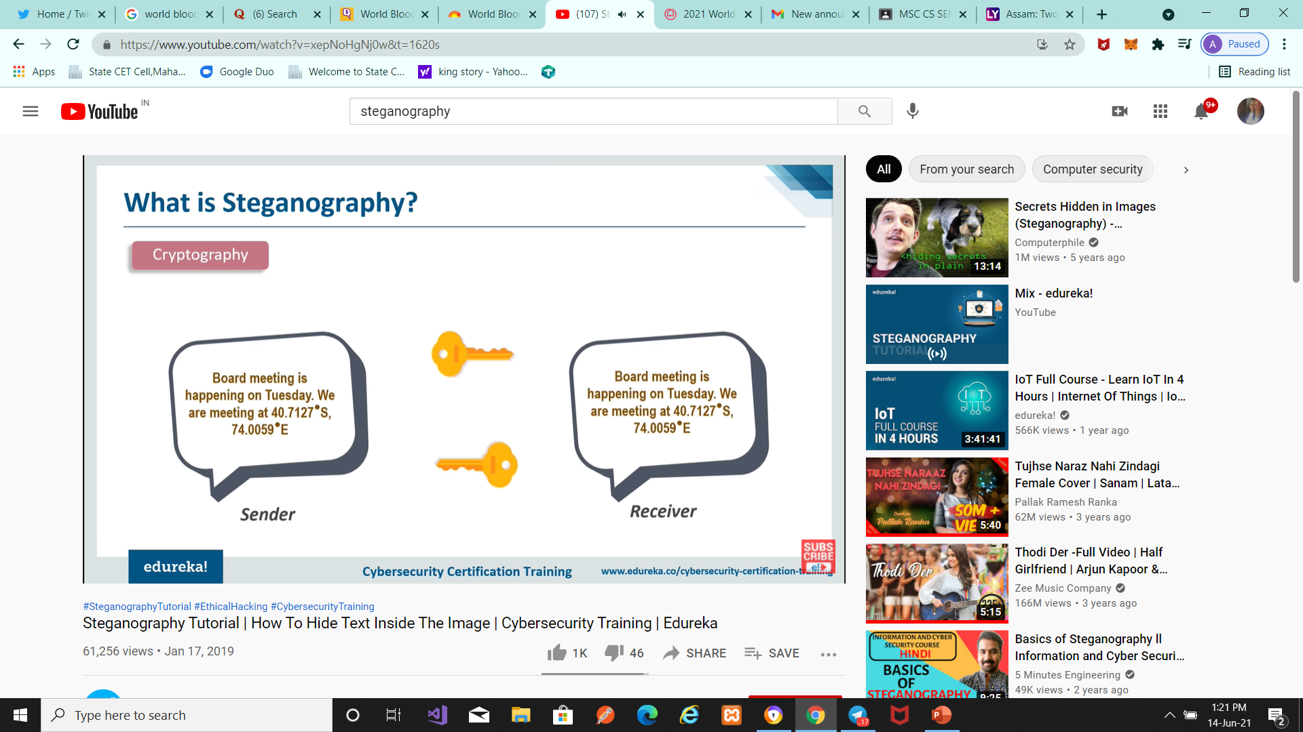

Introduction to Steganography

Slide 5
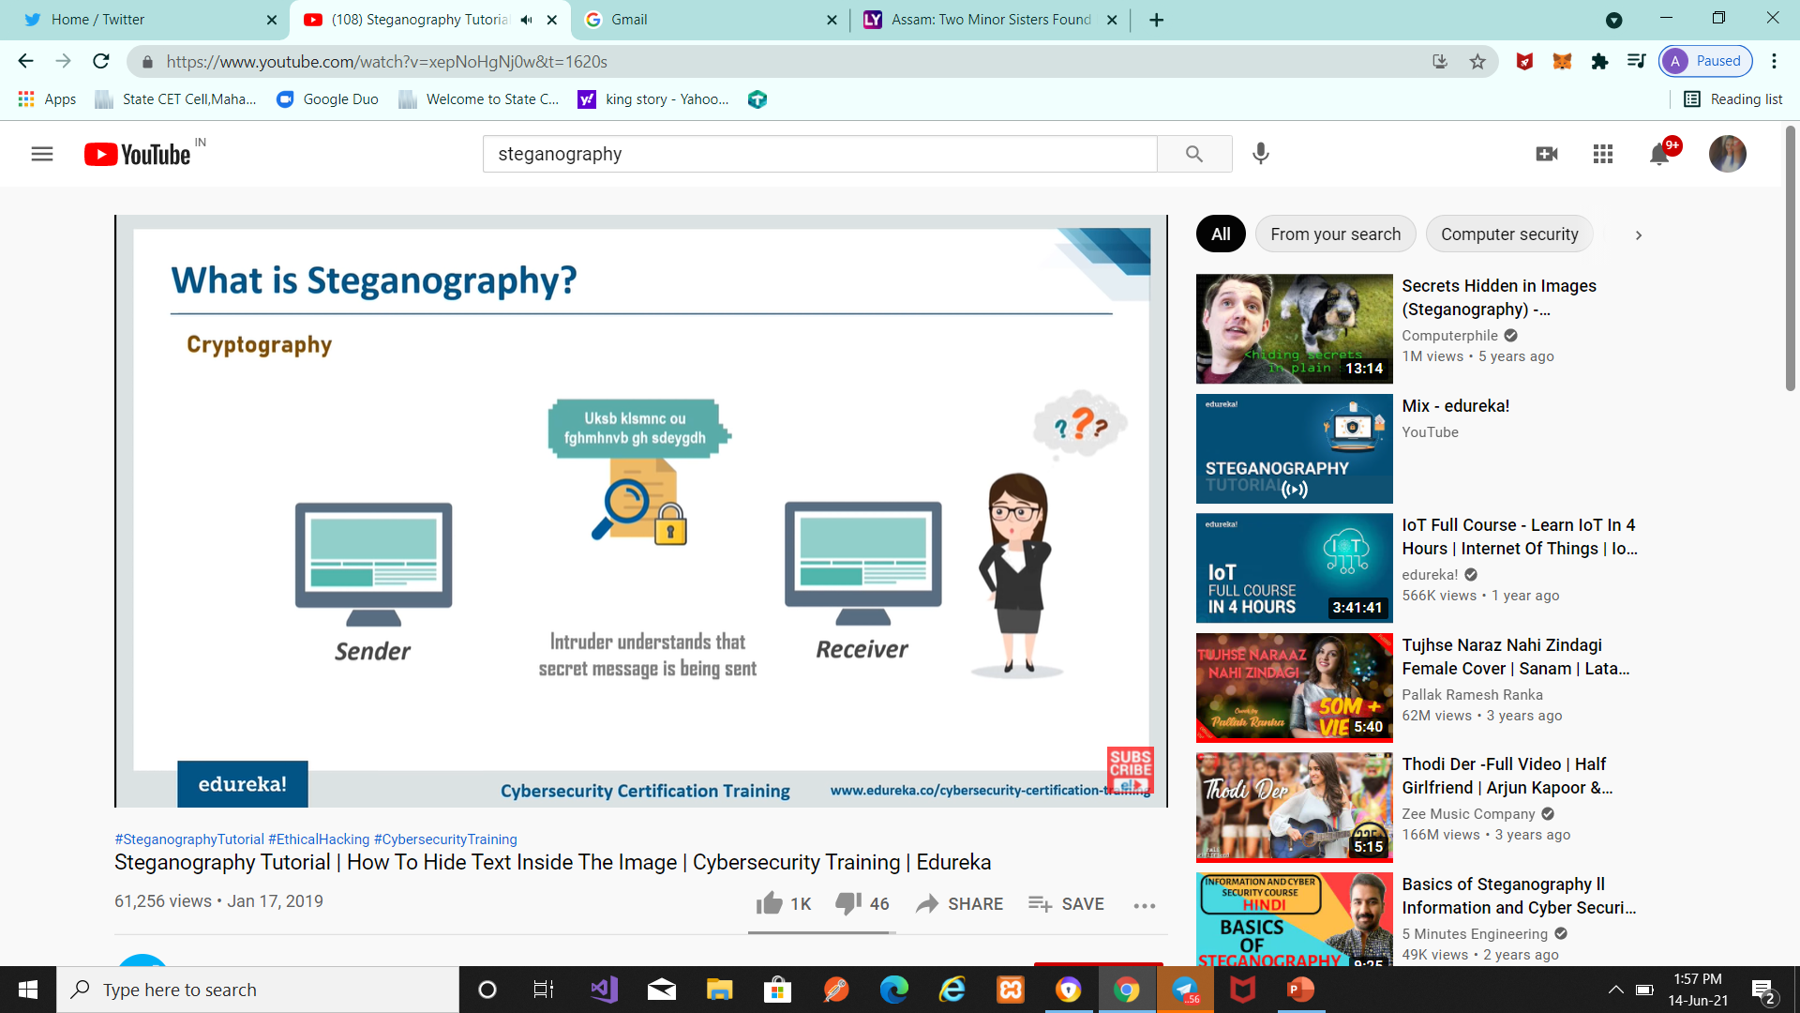
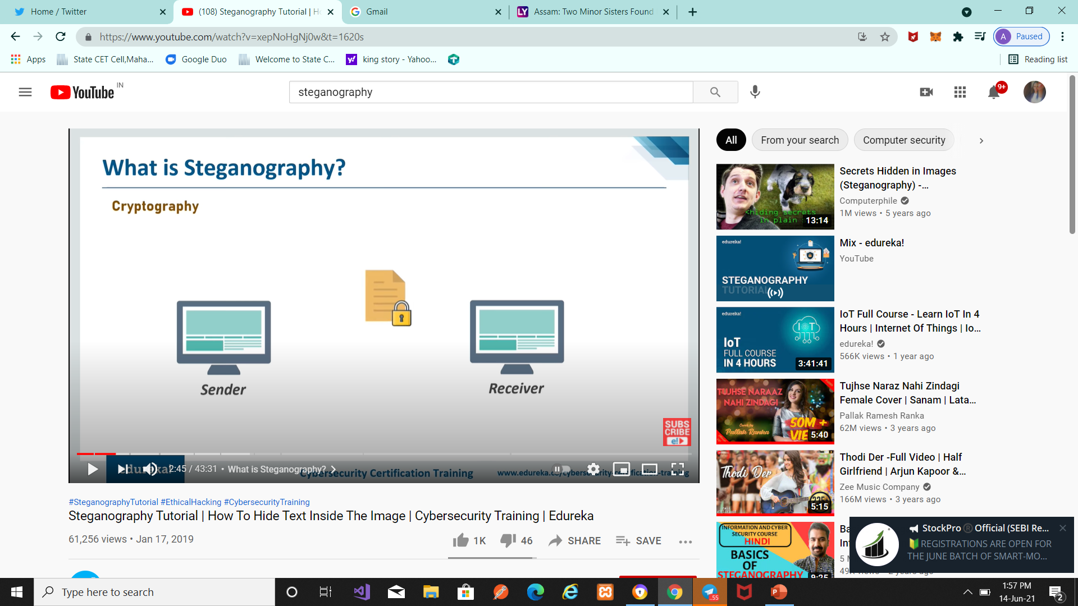
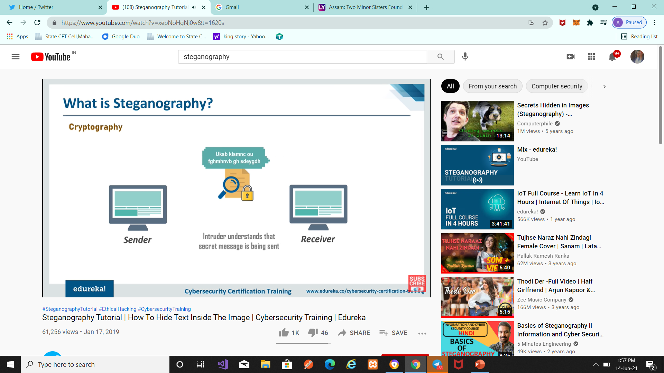
Introduction to Steganography

Slide 6
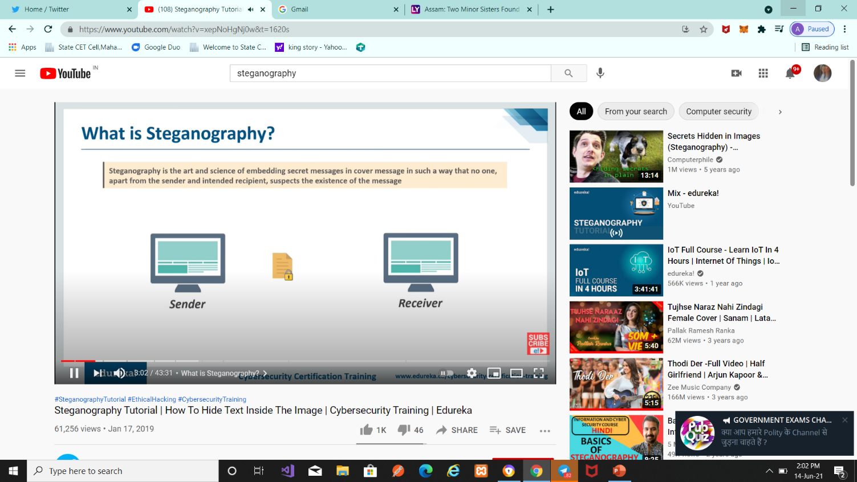
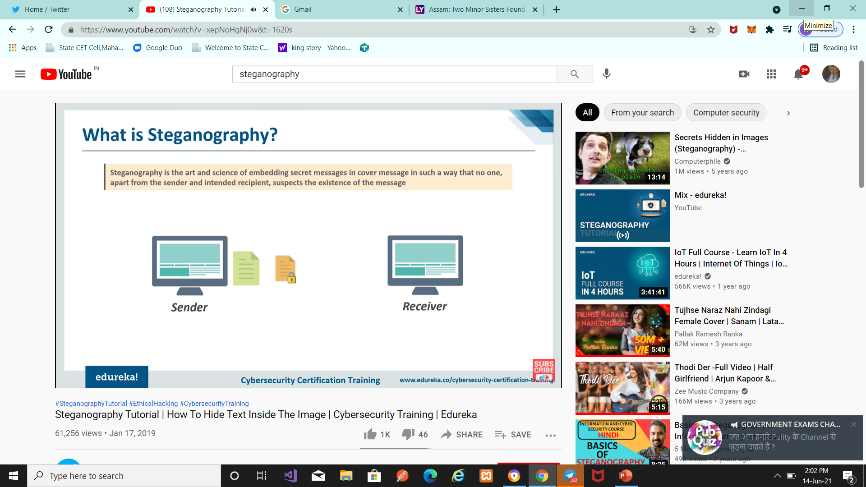
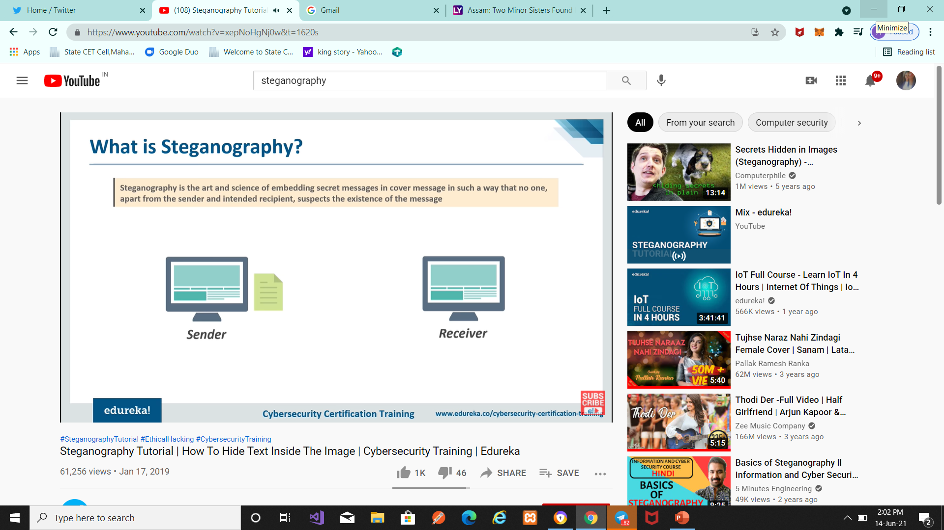
Introduction to Steganography

Slide 7
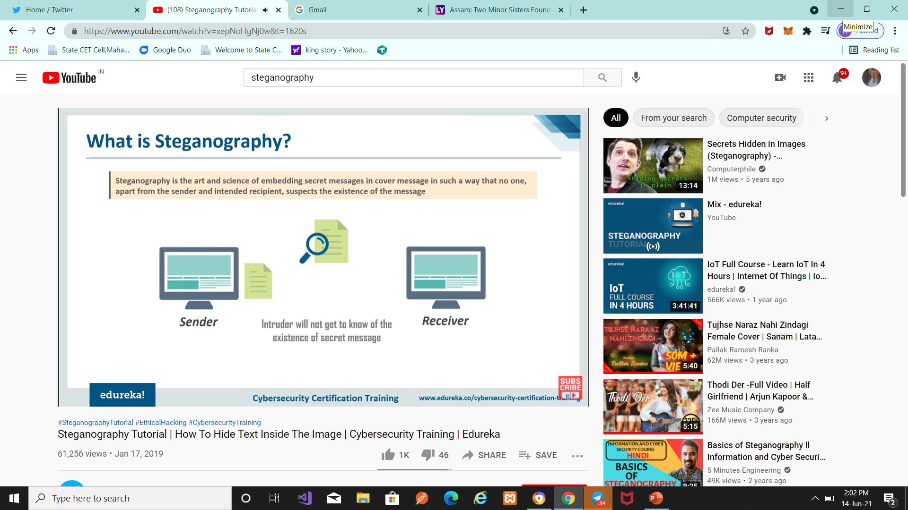
Introduction to Steganography

Slide 8
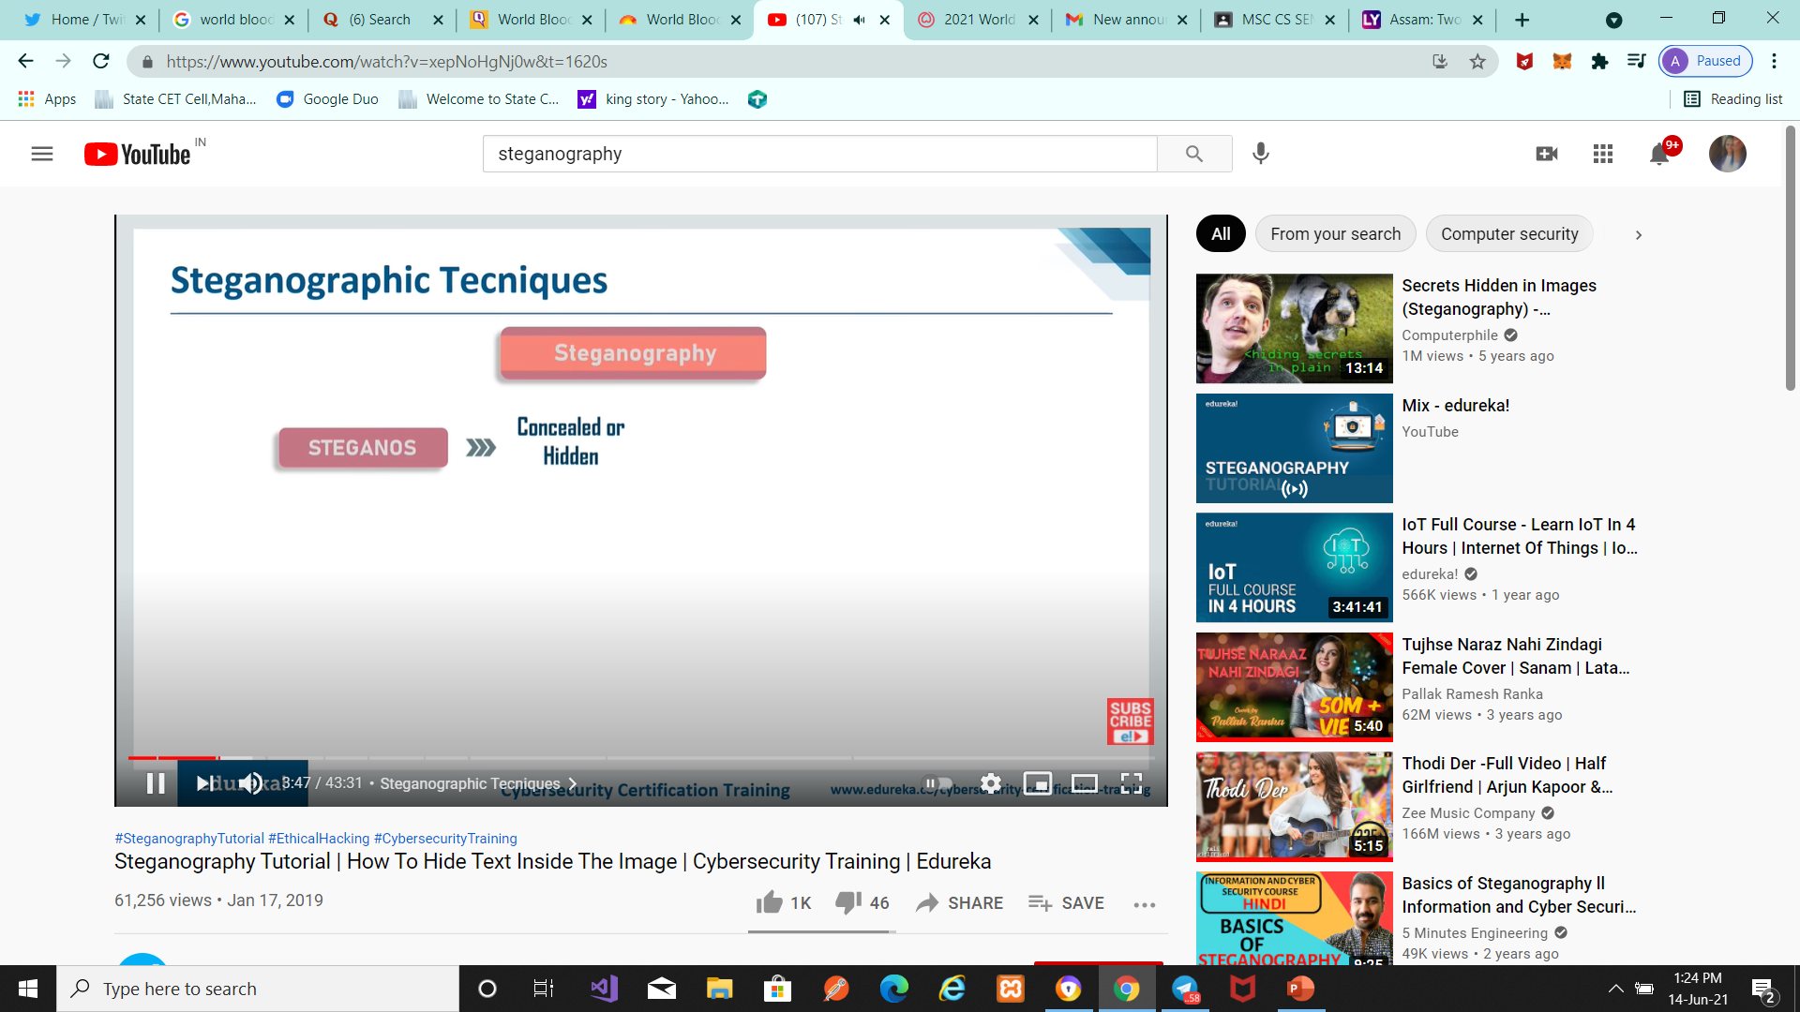
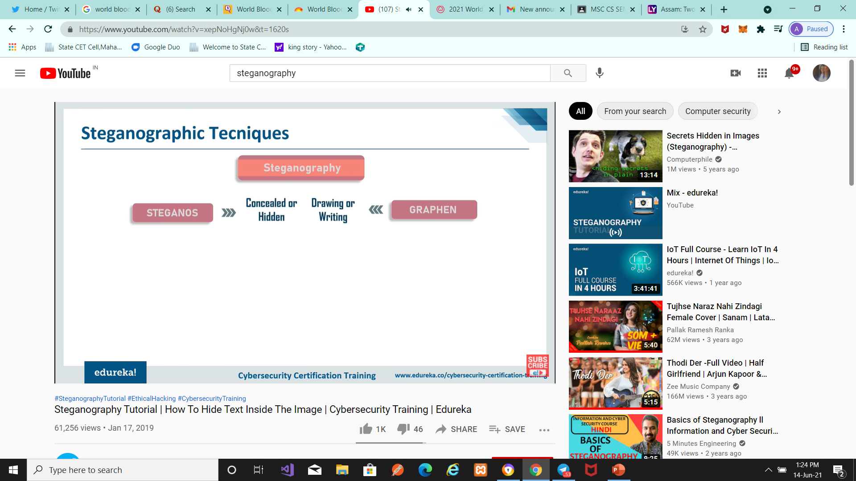
Steganography
Steganography Techniques

Slide 9
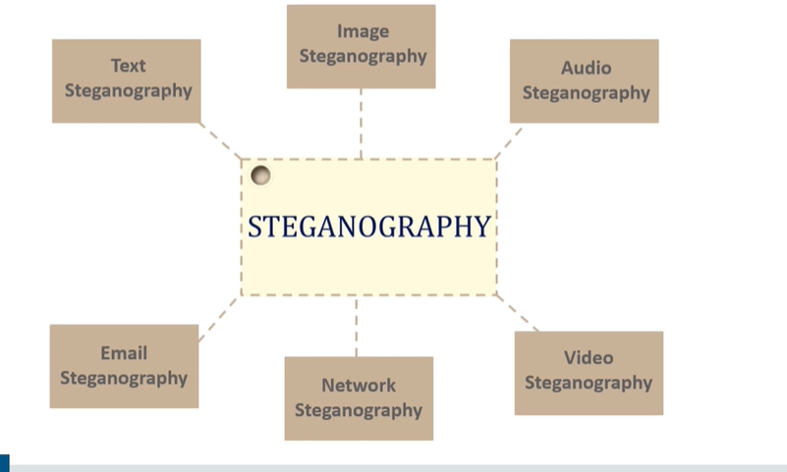
Steganography
Steganography Types

Slide 10
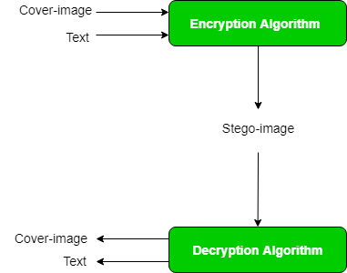
Concept of Image Steganography
Image Steganography refers to the process of hiding data within an image file.
Process of Image Steganography

Slide 11
Image Steganography
How is it done?
An image is represented as an N*M (in case of greyscale images) or N*M*3 (in case of colour images) matrix in memory, with each entry representing the intensity value of a pixel.
In image steganography, a message is embedded into an image by altering the values of some pixels, which are chosen by an encryption algorithm
Detection of the message within the cover-image is done
by the process of steganalysis .
While efforts are being invested in developing new algorithms
with a greater degree of immunity against such attacks, efforts are
also being devoted towards improving existing algorithms for steganalysis,
to detect exchange of secret information between terrorists or criminal elements.

Slide 12
Image Steganography and bitmap pictures –
Using bitmap pictures for hiding secret information is one of most popular choices for Steganography.
To use these software you must have a ‘BMP’ format of a pictures to use it,
Also we know that in the web most popular of image types are “JPEG” and other types not “BPM”, so we should have a solution for this problem.
Finally it give the only “BMP” image as an output that has hidden file inside it.

Slide 13
Implementation Of Image Steganography

Slide 14
Abstract -
Steganography is the art of hiding the fact that communication is taking place, by hiding information in other information.
Many different carrier file formats can be used, but digital images are the most popular because of their frequency on the internet.
For hiding secret information in images, there exists a large variety of steganography techniques some are more complex than others and all of them have respective strong and weak points.
Different applications may require absolute invisibility of the secret information, while others require a large secret message to be hidden.
This project report intends to give an overview of image steganography, its uses and techniques. It also attempts to identify the requirements of a good steganography algorithm and briefly reflects on which steganographic techniques are more suitable for which applications.

Slide 15
Requirements -
Software Requirements:
.NET Framework 3.5
Hardware Requirements:
Processor: Preferably 1.0 GHz or Greater.
RAM : 512 MB or Greater.

Slide 16
Objective -
The goal of steganography is to hide information within image file.
This approach of information hiding technique has recently became important in a number of application area
This project has following objectives:
To product security tool based on steganography techniques.
To explore techniques of hiding data using encryption module of this project
To extract techniques of getting secret data using decryption module.

Slide 17
Why This Steganography?
This technique is chosen, because this system includes not only imperceptibility but also un-delectability by any steganolysis tool.
Project Scope -
This project is developed for hiding information in any image file. The scope of the project is implementation of steganography tools for hiding information includes any type of information file and image files and the path where the user wants to save Image and extruded file.

Slide 18
Demonstration of Image Steganography

Slide 19
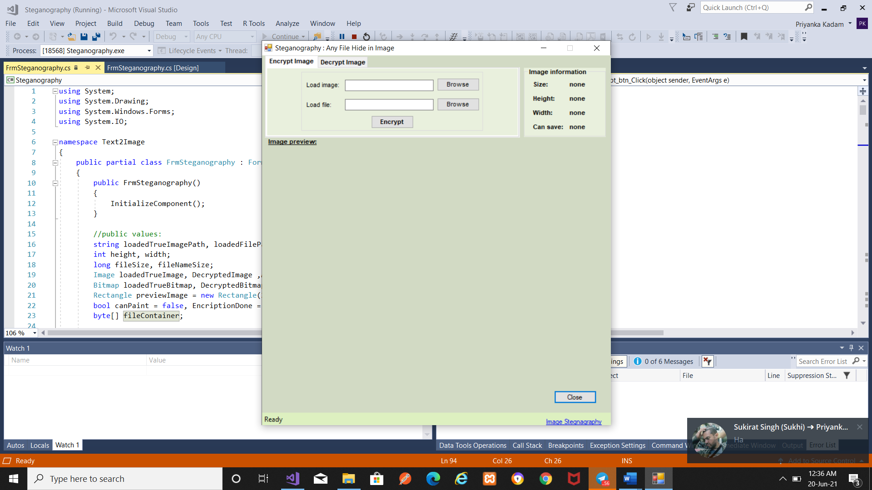

Slide 20
Conclusion -
Steganography is a really interesting subject and outside of the mainstream cryptography and system administration that most of us deal with day after day.
Steganography can be used for hidden communication. We have explored the limits of steganography theory and practice. We printed out the enhancement of the image steganography system using LSB approach to provide a means of secure communication. A stego-key has been applied to the system during embedment of the message into the cover image.
This steganography application software provided for the purpose to how to use any type of image formats to hiding any type of files inside their.

Slide 21
Future Enhancement
To make it pure steganography application.
May be there is still room for a lot of improvements, but will leave that for the future work on this topic.

